Slide 1





SCORE
2024
Snake
The
Game
B
START
A
SAVE
Bastien JAMET & Charles CLERC

Slide 2
Summary
1
Description of our project
2
Software requirements
3
Design of the project
4
Testing
5
Demonstration

Slide 3



Description of our project
Web based project
Player controls
HTML, CSS, Javascript
Objective: recreate a fluid, engaging and visually appealing game that enhances the original Snake game

Slide 4
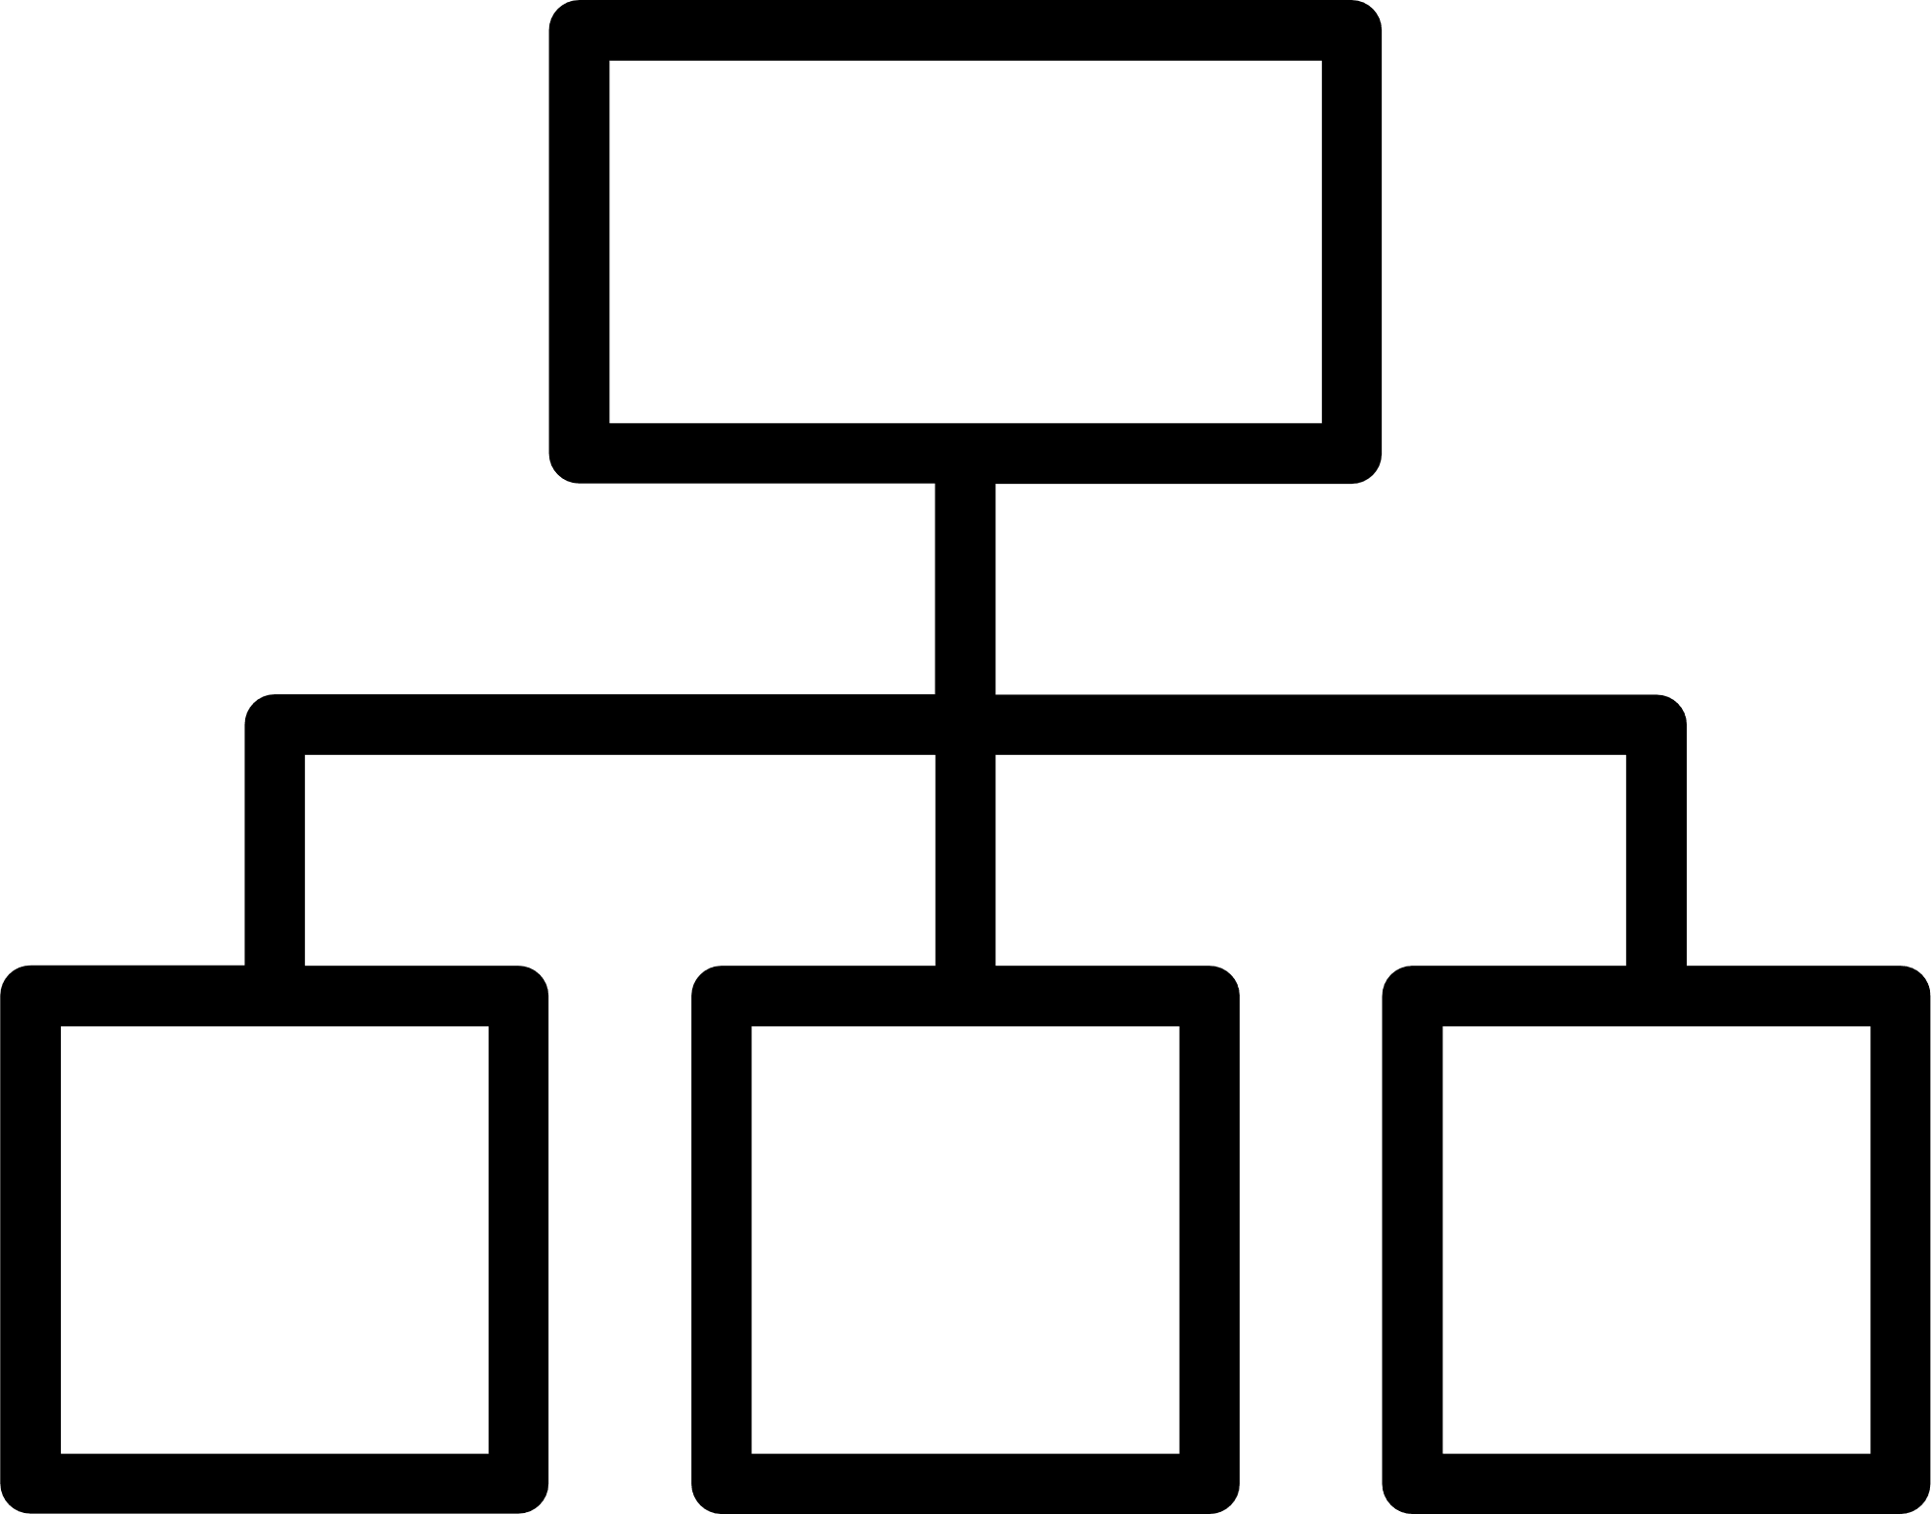

Description of our project
Project Structure
Snake.html: main file structuring the game’s interface
style.css: file designing the game
script.js: file containing the game’s script
Features
Snake movement/ growth
Apple generation
Score tracking
Collision detection
Customizable themes

Slide 5




Software requirements
Visualisation
Game initialization
Snake generation
Apple generation
Grid generation
Usabilty
Performance
Lag free
Compatibilty
Smooth gameplay
Local score
Customizable
Game termination
Saving highscore

Slide 6

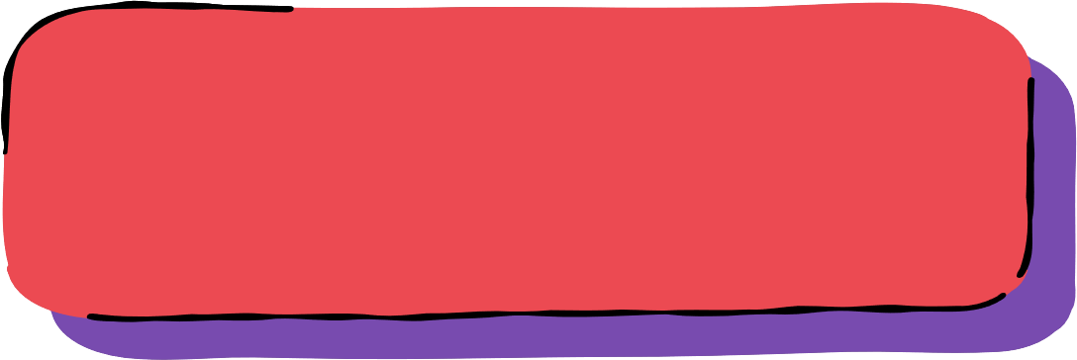
Design of the project
Design 1 | Design 2
Classes: Snake Apple Interface User Score : clear and modular, easier to maintain and extend : might require more code for integration | Classes: Game (Snake, Apple, Interface, Score) User : simpler, fewer classes, easier integration : less modular, harder to extend

Slide 7
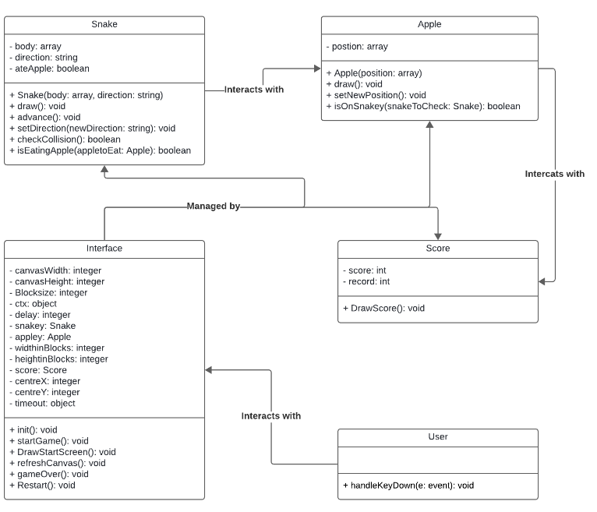
Design of the project

Slide 8


Testing
Very simplified Black-Box Test Plan :
Test ID | Description | Expected Results | Actual Results
Directions | UP, DOWN, LEFT, RIGHT | Snake should go in the desired direction
Apple |  | The snake will eat the apple, another one will randomly spawn
Score | Score value | The score should be able to be reset, see the previous one and the best
System | Configuration of the software, version and UI | The game should run on every system

Slide 9
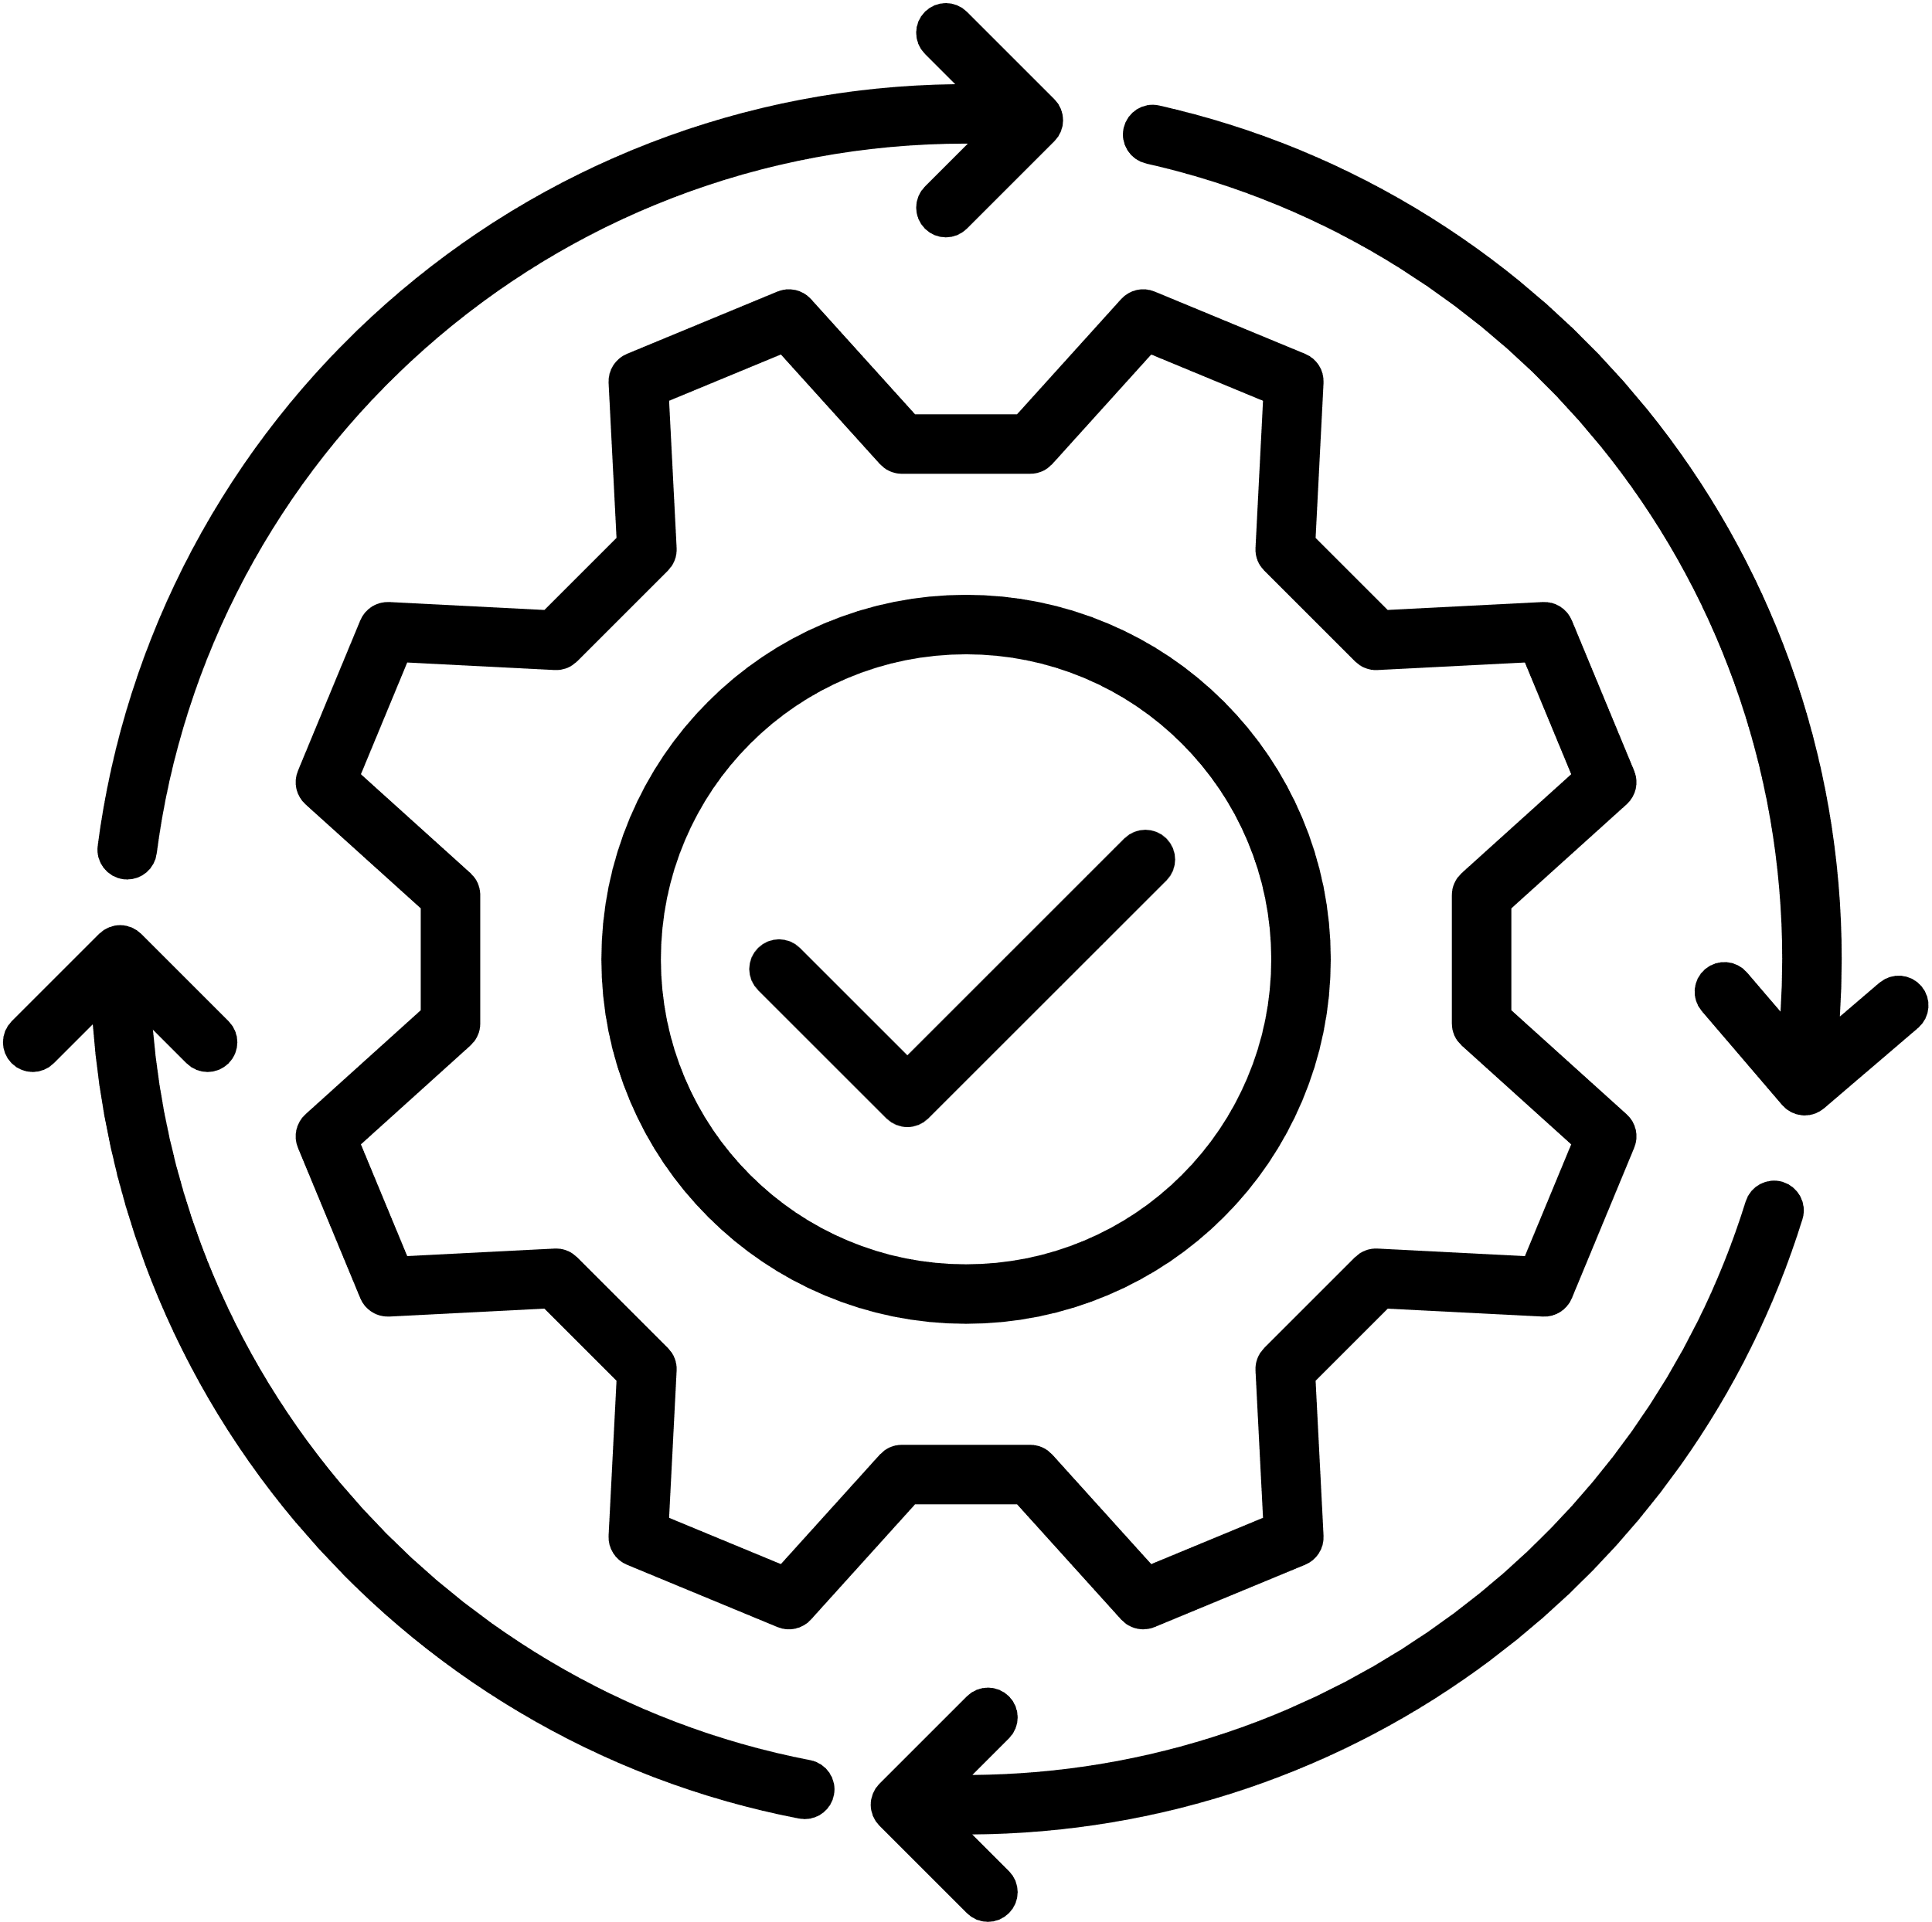

Testing
Runs on Windows and Mac without a hitch
For fluidity reasons, game is hosted on a website
Prefered exploitation systems using HTML 5 update
as it enables optimization with the line of code: rel="preconnect"
Limited in its display, but can be played in portrait mode on a wide range of devices such as phones, tablets and computers.
But to be able to play in landscape mode, the device must have a screen height greater than 800 pixels when turned upside down.

Slide 10
Demonstration
LET’S PLAY
B
START
Press space to play
A
SAVE

